Slide 1

Introduction to Support Vector Machines (SVMs)
Support Vector Machines (SVMs) are a powerful machine learning algorithm used for classification and regression tasks. They work by finding the optimal hyperplane that separates different classes of data with the largest possible margin.

Slide 2
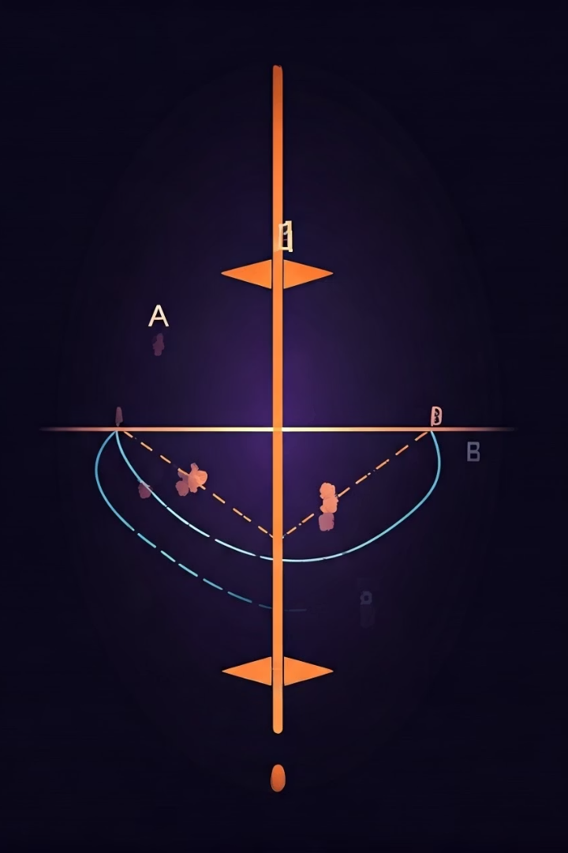
What are SVMs?
SVMs are supervised learning models that analyze data for classification and regression analysis. They work by identifying the optimal hyperplane that maximizes the margin between two or more classes of data points.

Slide 3
Linear SVMs
Linear Separation
Support Vectors
For linearly separable data, SVMs find the optimal hyperplane that best divides the classes with the largest margin.
The data points closest to the hyperplane are called support vectors, and they define the maximum-margin hyperplane.

Slide 4
Nonlinear SVMs and the Kernel Trick
Nonlinear Problems
Kernel Functions
For data that is not linearly separable, SVMs use the "kernel trick" to map the data into a higher-dimensional feature space where it becomes linearly separable.
Popular kernel functions include the linear, polynomial, and radial basis function (RBF) kernels, which allow SVMs to handle a wide range of nonlinear problems.

Slide 5

Margin Maximization and Hyperplane Selection
1
Margin Maximization
SVMs find the hyperplane that maximizes the distance (margin) between the decision boundary and the nearest data points of each class.
2
Hyperplane Selection
The support vectors, which lie on the margin, are the most important data points in determining the optimal hyperplane.

Slide 6

Advantages and Disadvantages of SVMs
Advantages
High accuracy for a variety of problems
Effective in high-dimensional spaces
Versatile with different kernel functions
Disadvantages
Computationally expensive for large datasets
Hyperparameter tuning can be challenging
Interpretation of the model can be difficult

Slide 7
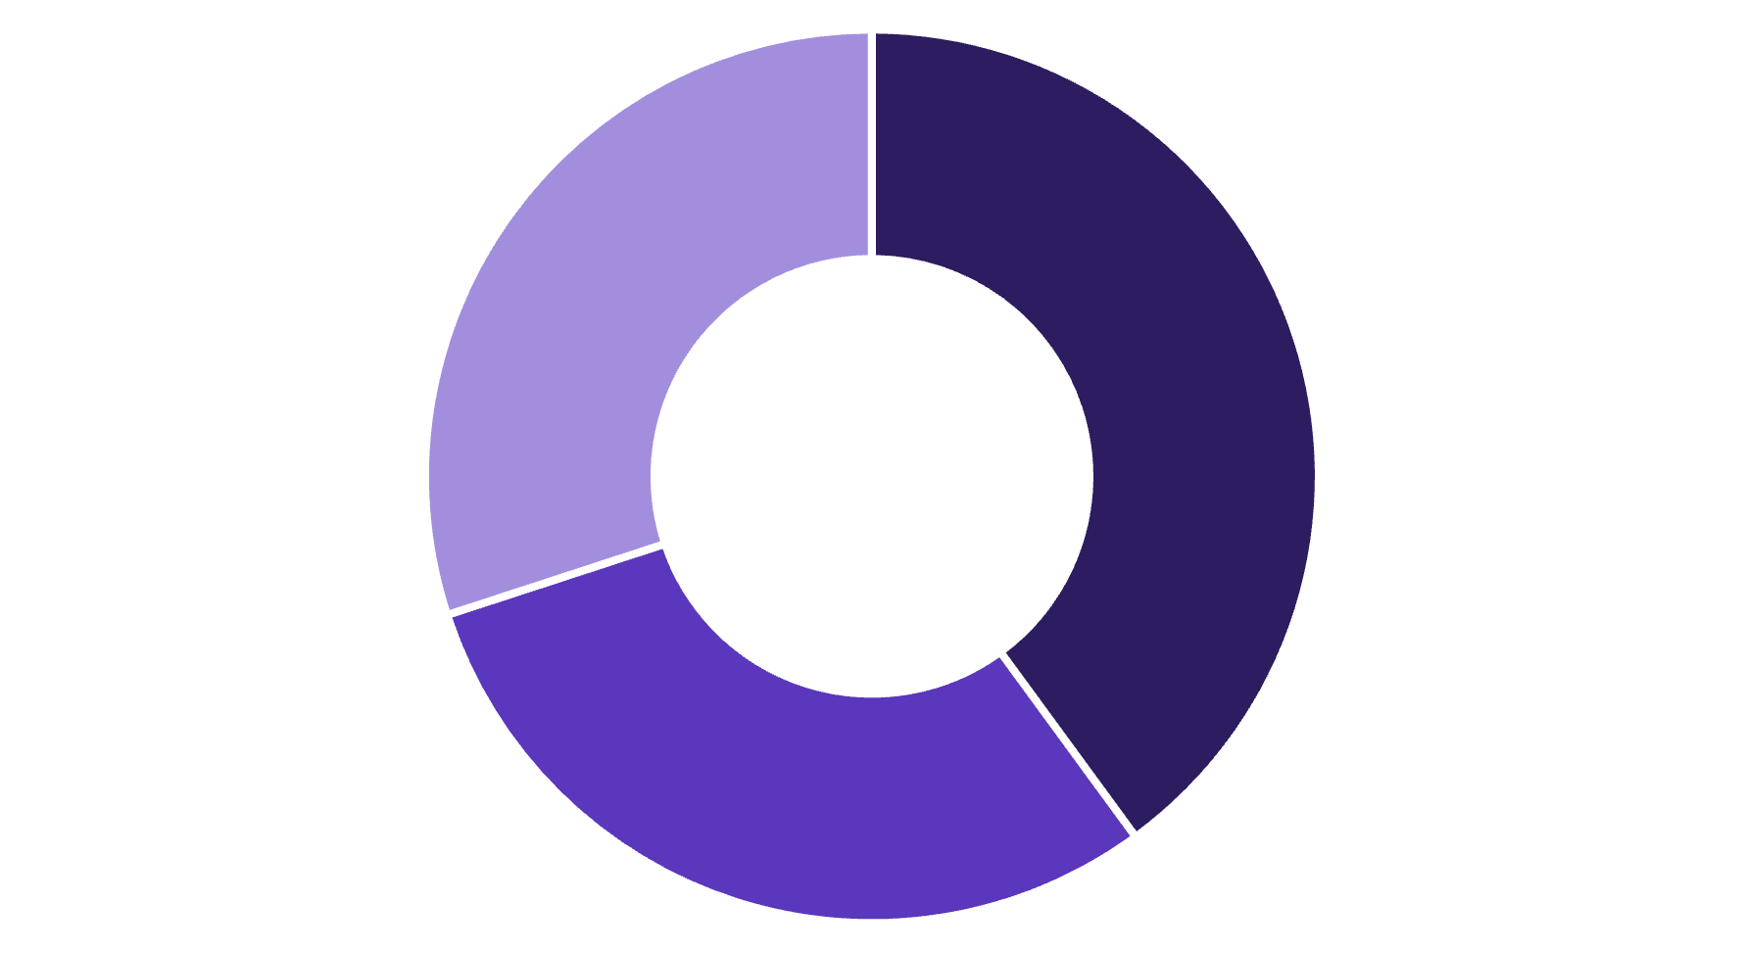
Visualizing SVM Decision Boundaries
Linear
Polynomial
RBF
The choice of kernel function in SVMs determines the shape of the decision boundary. Linear SVMs produce linear decision boundaries, while polynomial and RBF kernels can create more complex, nonlinear boundaries to better fit the data.

Slide 8


Applications of SVMs
Image Classification
Text Analysis
Bioinformatics
Finance
SVMs are used for text classification tasks like spam detection, sentiment analysis, and document categorization.
SVMs are applied in bioinformatics for tasks like protein structure prediction and microarray data analysis.
SVMs are used for financial modeling, credit scoring, and stock market prediction.
SVMs excel at classifying images into different categories, such as facial recognition or object detection.

